Slide 1

PSMA theragnostics-2 Prof John Buscombe

Slide 2
Lecture plan
Historical use of J591 antibody
PSMA radioligand therapy
Trials with PSMA therapy
Thera-P and VISION trial
New trials
Alpha emitters

Slide 3
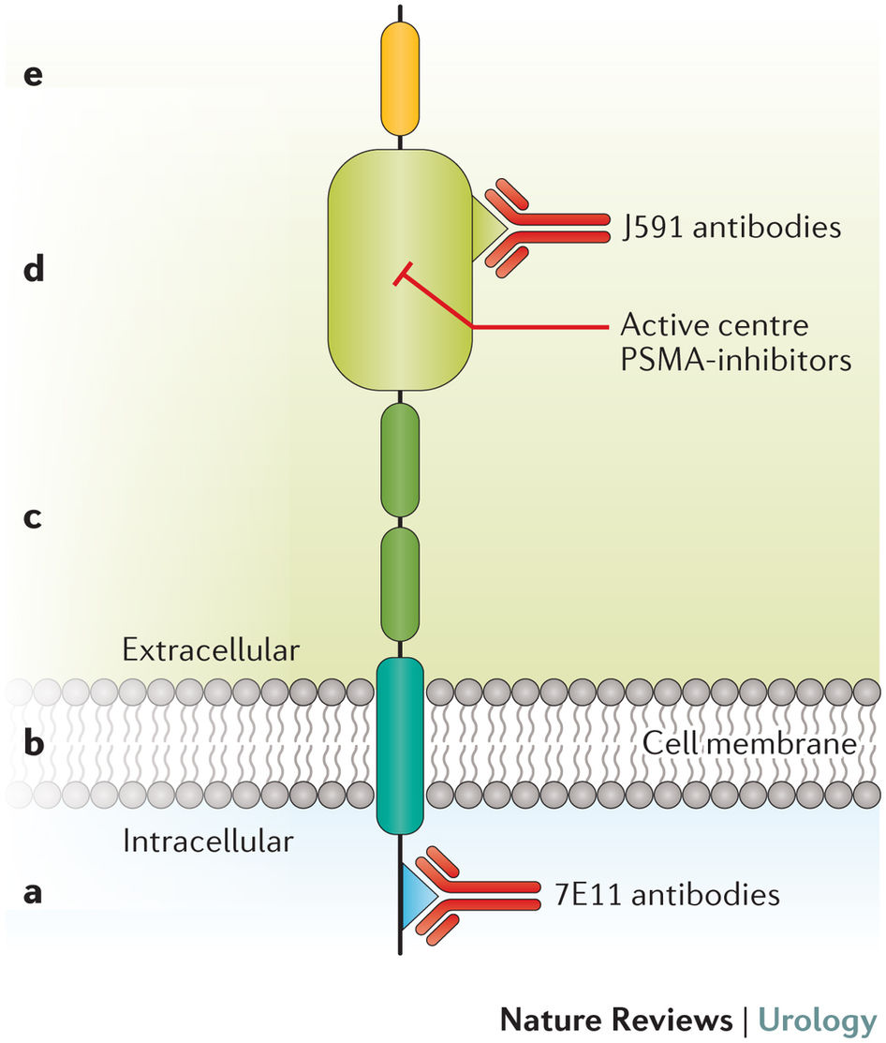
PSMA (Glutamate carboxypeptidase II) structure

Slide 4
RIT in Cancer of the Prostate
Best target looks to be not PSA which is released into blood and occurs of dead cells but Prostate specific Membrane antigen-PSMA
Anti-PSMA antibodies developed
Binds to external domain of PSMA
Radiolabelled by metals eg In-111, Y-90 and Lu-177 via DOTA
Involved in uptake of glutamate and folate needed for cell division

Slide 5
Phase I trials of Y-90 J591
Milowsky et al JCO 2004
J Clin Oncol 2004 2522
Looked at hormone resistant prostate cancer
Dose escalation trial 185-3700 MBq per m²
Pre-imaging with In-111 J591
Used CT and PSA to monitor treatment

Slide 6
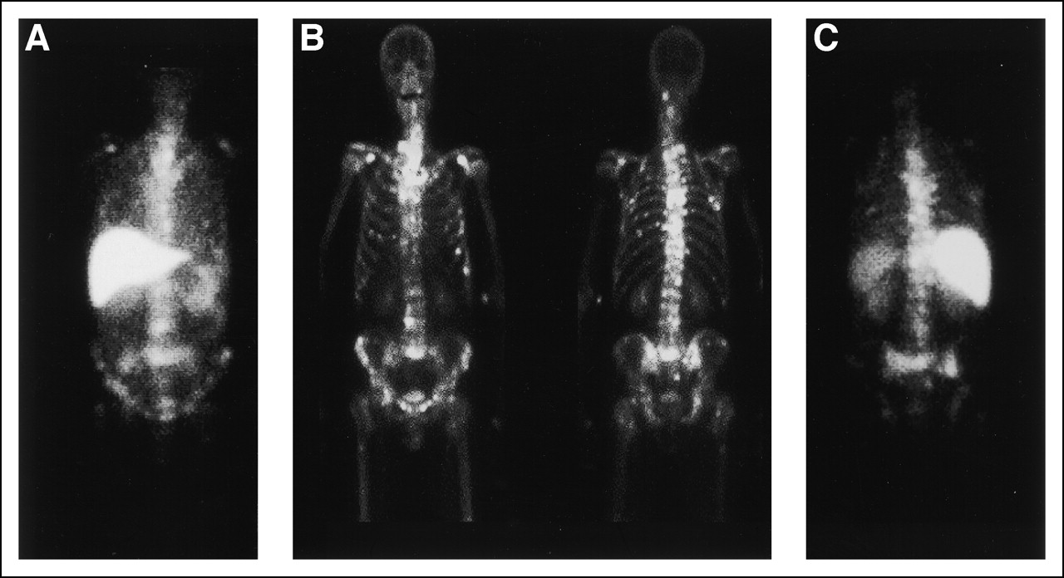
Fig 1. Anterior and posterior (B) views of bone scan flanked by the respective indium-111 (111In)-J591 images (A, C)
Milowsky, M. I. et al. J Clin Oncol; 22:2522-2531 2004

Slide 7
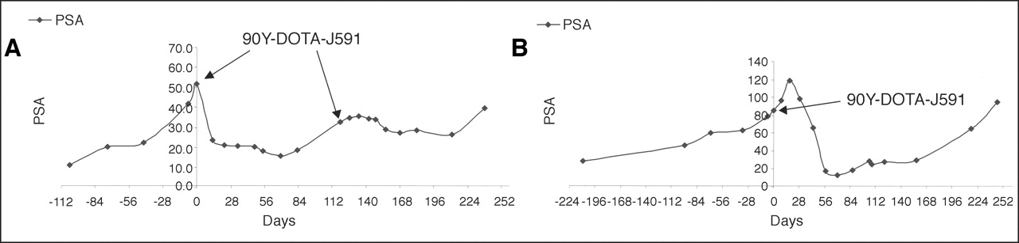
Fig 2. Prostate-specific antigen (PSA) graphs for two patients at the 20 mCi/m2 dose level, demonstrating 70% (A) and 85% (B) declines in PSA lasting 8 and 8.6 months, respectively
Milowsky, M. I. et al. J Clin Oncol; 22:2522-2531 2004

Slide 8
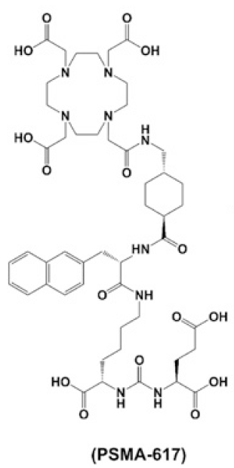
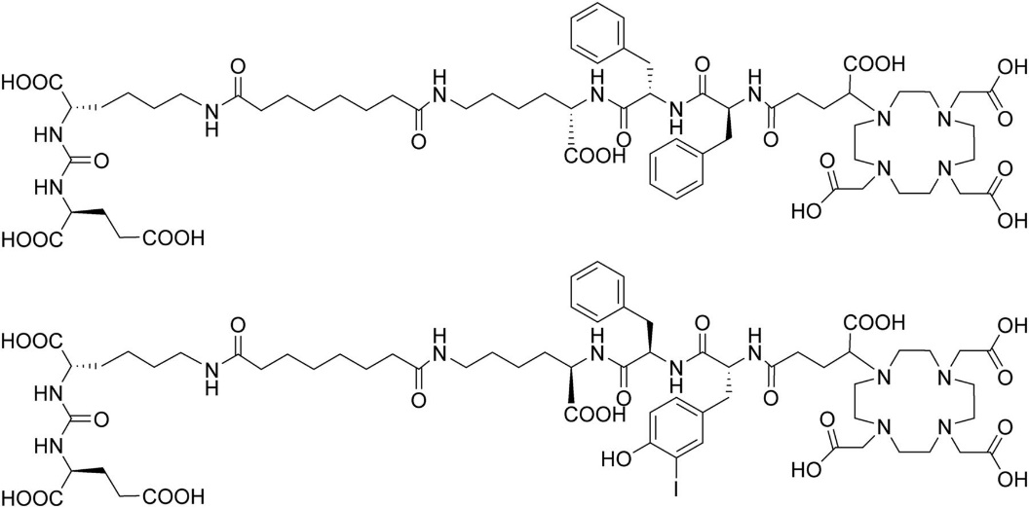
PSMA ligands: lysine-glutamate-urea derivatives
PSMA-11
DOTAGA-FFK(Sub-KuE)
PSMA I&T
Notes:
A similar example is given by the PSMA ligands. These new compounds based on lysine-glutamate-urea derivatives, first developed as inhibitors of the enzymatic activity of PSMA, have been labelled by a variety of radionuclides for imaging or therapy of prostate cancer. A variety of closely related compounds are under investigation.

Slide 9
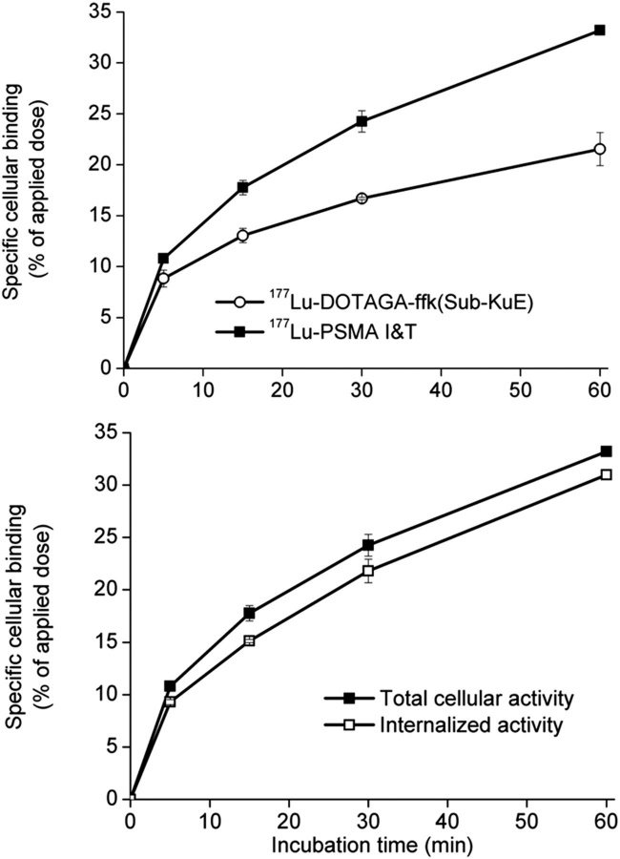
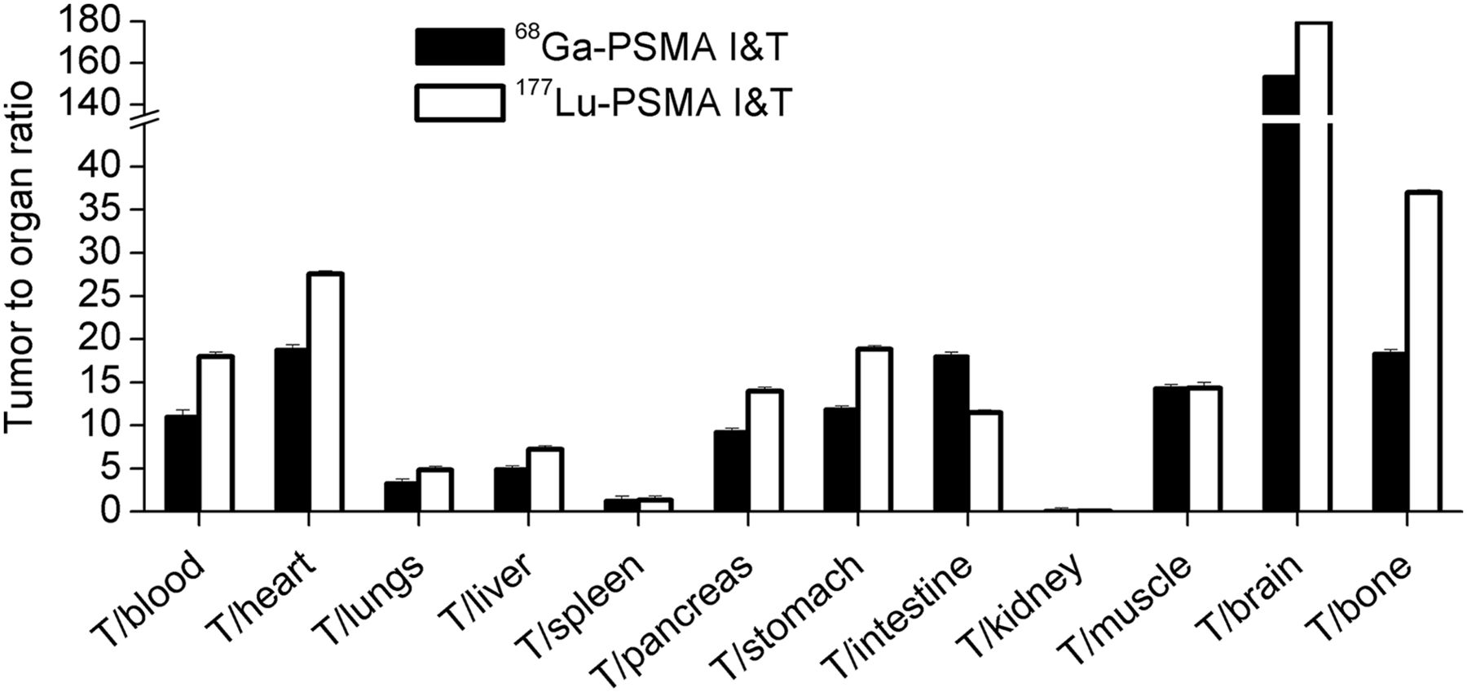
Preclinical studies with PSMA ligands
Tumor-to-organ ratios of dual-tracer biodistribution of ⁶⁸Ga- and ¹⁷⁷Lu-PSMA I&T at 1 h after injection in LNCaP tumor–bearing CD-1 nu/nu mice (n = 4).
Weineisen M et al. ⁶⁸Ga- and ¹⁷⁷Lu-Labeled PSMA I&T: Optimization of a PSMA-Targeted Theranostic Concept and First Proof-of-Concept Human Studies. J Nucl Med. 2015, 56:1169-76.
Specific binding kinetics of ¹⁷⁷Lu-PSMA I&T and ¹⁷⁷Lu-DOTAGA-ffk(Sub-KuE) (upper) Specific binding and internalization kinetics of ¹⁷⁷Lu-PSMA I&T at 37°to LNCaP cells (lower)
Notes:
In preclinical studies, again, candidates are compared in a variety of experiments. Here for instance, the specific binding kinetics of ¹⁷⁷Lu-PSMA I&T and of ¹⁷⁷Lu-DOTAGA-ffk(Sub-KuE) (upper) and the specific binding and internalization kinetics of ¹⁷⁷Lu-PSMA I&T at 37°C to LNCaP cells are shown. It is important that binding to tumour cells be fast and internalization is favourable for long term retention of residualizing radioactive metals.
Biodistribution studies are also important to check for possible non-specific uptake. Here both gazlium-68 an lutetium-177 labelled compounds show very similar biodistribution, favourable to a theranostic use.

Slide 10
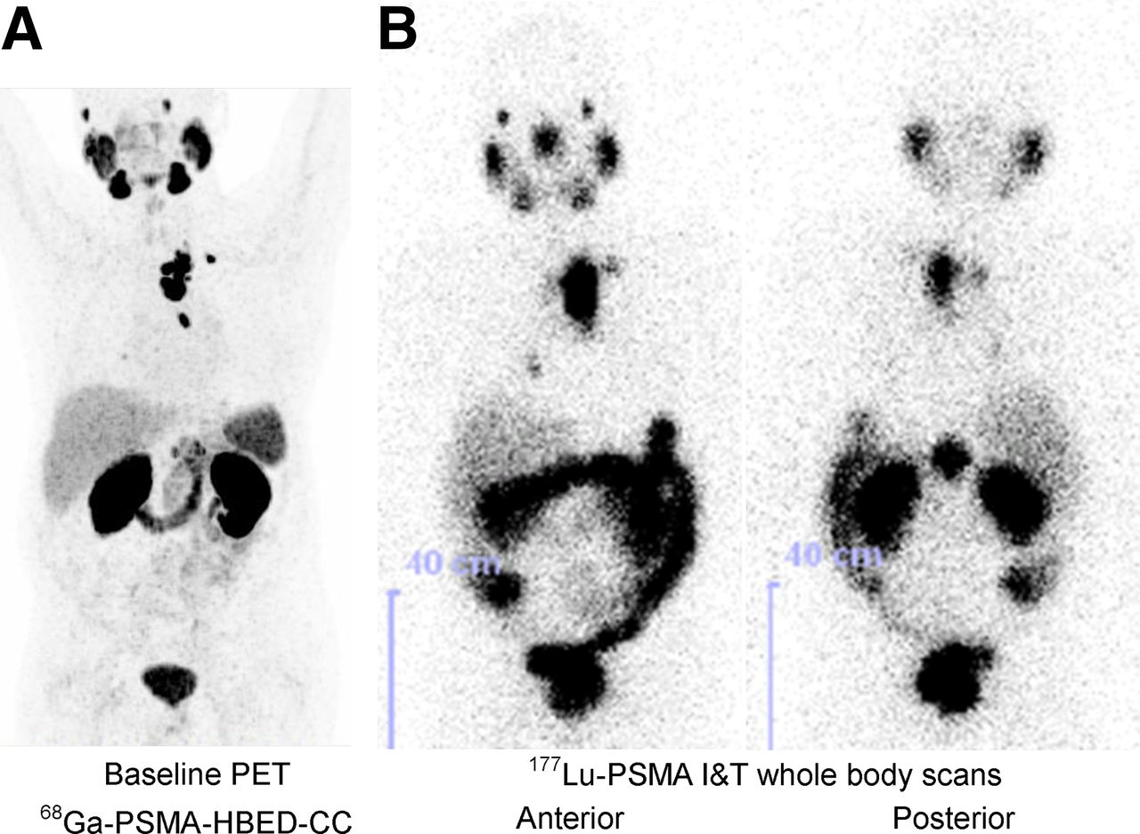
Theranostic approach
High but not critical salivary glands and kidneys absorbed doses
Tumour-to-kidney ratios comparable to those with RLT agents currently available for the treatment of NETs.
Phase I with escalated activities and dosimetry study should be performed.
Weineisen M et al. ⁶⁸Ga- and ¹⁷⁷Lu-Labeled PSMA I&T: Optimization of a PSMA-Targeted Theranostic Concept and First Proof-of-Concept Human Studies. J Nucl Med. 2015, 56:1169-76.
Notes:
Maximum-intensity projection of ⁶⁸Ga-PSMA-HBED-CC PET/CT (164 MBq, 60 min after injection, left) showed intense tracer accumulation in mediastinal lymph node metastases. These mediastinal lymph nodes demonstrated high ¹⁷⁷Lu-PSMA I&T uptake 47 h after therapy with 5.7 GBq of ¹⁷⁷Lu-PSMA I&T.
The images also show high uptake in salivary glands, which are known to express PSMA. This uptake is currently considered not critical, although destruction of salivary glands can result in the dry mouth symptom. Kidney uptake is also high as expected, but not higher than that of other compounds, such as somatostatin analogues used with success for therapy.

Slide 11
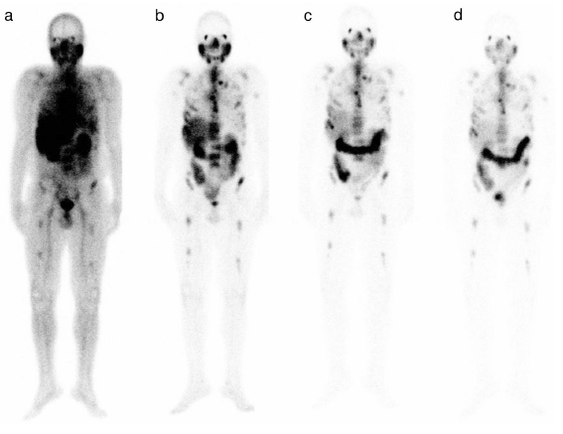
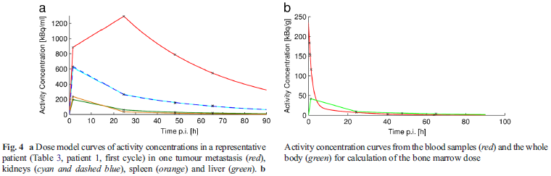
PSMA ligands in prostate cancer
Delker A et al. Dosimetry for ¹⁷⁷Lu-DKFZ-PSMA-617: a new radiopharmaceutical for the treatment of metastatic prostate cancer. Eur J Nucl Med Mol Imaging. 2016, 43:42-51.
Notes:
Clinical trials for the therapy of prostate cancer have started in several different institutions, with different compounds. Preliminary results and dosimetry studies are quite promising.

Slide 12
Lu-177 PSMA Kulkarni et al JNM 2014
Based at Bad Berka
Used Lu-177 PSMA TUM1
6 patients with metastatic prostate cancer
All positive on Ga-68 PSMA imaging
Single treatment of 6GBq Lu-177 PSMA
Well tolerated
2 patients had formal PR
Some progression of bone mets

Slide 13
Response to Lu-177 617PSMA Ferdinandas et al JNM 2016
Reviwed Lu-177 PSMA therapy in 40 patients
All had metastatic CaP and failed hormonal/chemo therapy
Predictors of poor prognosis
Young age
High PSA, gGT, CRP, Pt count
High Gleason score
Need for continued pain relief
Other authors note liver mets are a poor prognostic sign

Slide 14
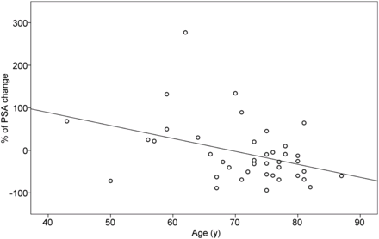
Response vs age
Ferdinandas et al JNM 2016

Slide 15
Safety and Efficacy of Ga-68 PSMA Baum et al JNM 2016
Dosimetry of first 30 patients treated
Low level of side effects though dry mouth in 2/30
Highest radiation dose to parotid glands, then kidneys
No bone marrow toxicity seen
80% of patients saw a reduction in PSA
Radiological partial response in 30%
Of those with bone pain some pain relief in 33%
Therapy can be repeated at 6 week intervals
Median PFS was 13 months, Mean OS not reached but >28 months

Slide 16
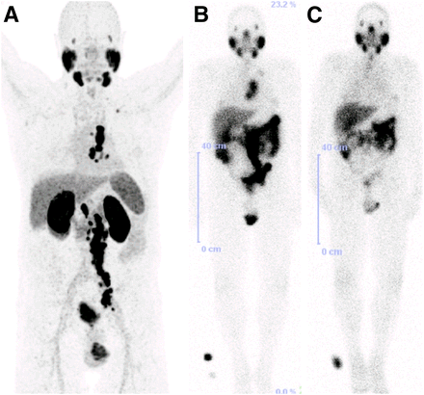
Response Baum et al JNM 2016
70-y-old patient with PSMA-avid lymph node metastases on ⁶⁸Ga-PSMA PET/CT before therapy (A) and on ¹⁷⁷Lu-PSMA scintigraphy after first PSMA RLT (B), with remarkable reduction in uptake after second PSMA RLT (C). Results were consistent with excellent therapy response.

Slide 17
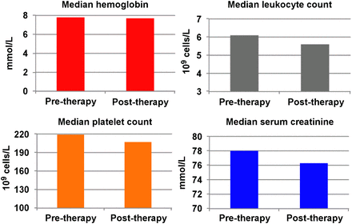
Safety Baum at al JNM 2016
Comparison of median laboratory parameters before and after PSMA RLT, revealing no significant hematotoxicity or nephrotoxicity.

Slide 18
TheraP trial
Phase II multi-centre open label trial
Comparing Lu-177 PSMA vs carbitaxel in patients with metastatic prostate cancer who failed endocrine and 1st line chemotherapy
Lu-177 PSMA given at rate of 7.4GBq x4 6 weeks apart
Carbitaxel 20mg/m² x10 every 3 weeks
Response defined as drop on PSA of >50%
Patients excluded in FDG+PSMA- lesions
Published by Hofman et al Lancet 2021

Slide 19
TheraP methodology
101 patient randomised to carbitaxel
291 men with known metastatic Ca Prostate entered
200 had positive Ga-68 PSMA PET scanning
99 patient randomised to Ga-68 PSMA

Slide 20
TheraP results
66%
Grade 3-4 adverse events occurred in 33% of those treated with Lu-177 PSMA and 53% of those treated with carbitaxol

Slide 21
VISION trial
Multinational phase 3 trial
Patients needed to be positive on Ga-68 PSMA PET scan, have failed hormone therapy and at least 1 full cycle of taxane chemotherapy
1179 patients screened, 831 eligible
Randomised to 6x7.4 GBq Lu-177 PSMA six weekly or standard of care at ratio of 2:1
Primary end point was improved survival
Presented at ASCO 2021 and in NEJM Oct 2021

Slide 22
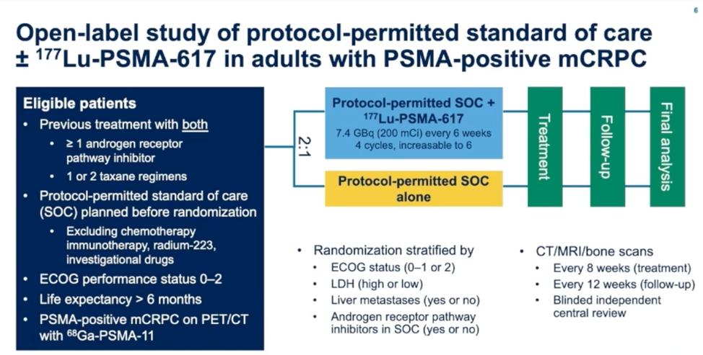
VISION trial general plan

Slide 23
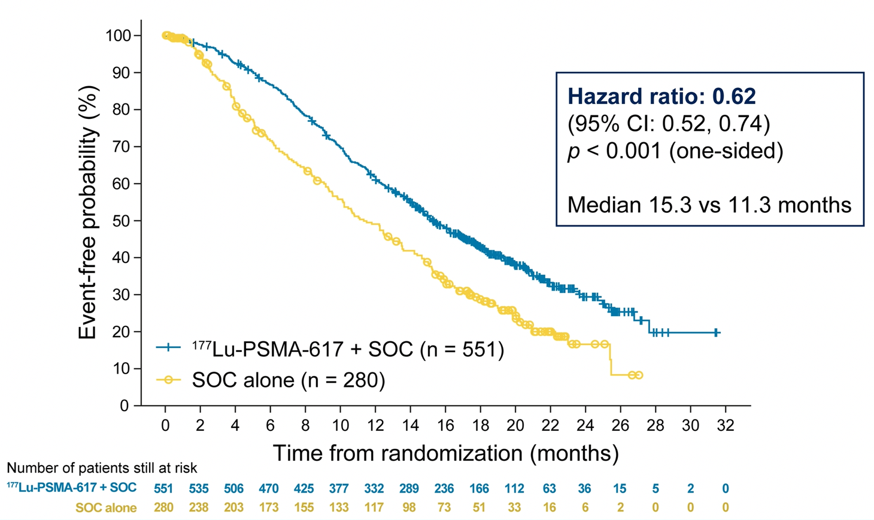
Changes in overall survival

Slide 24
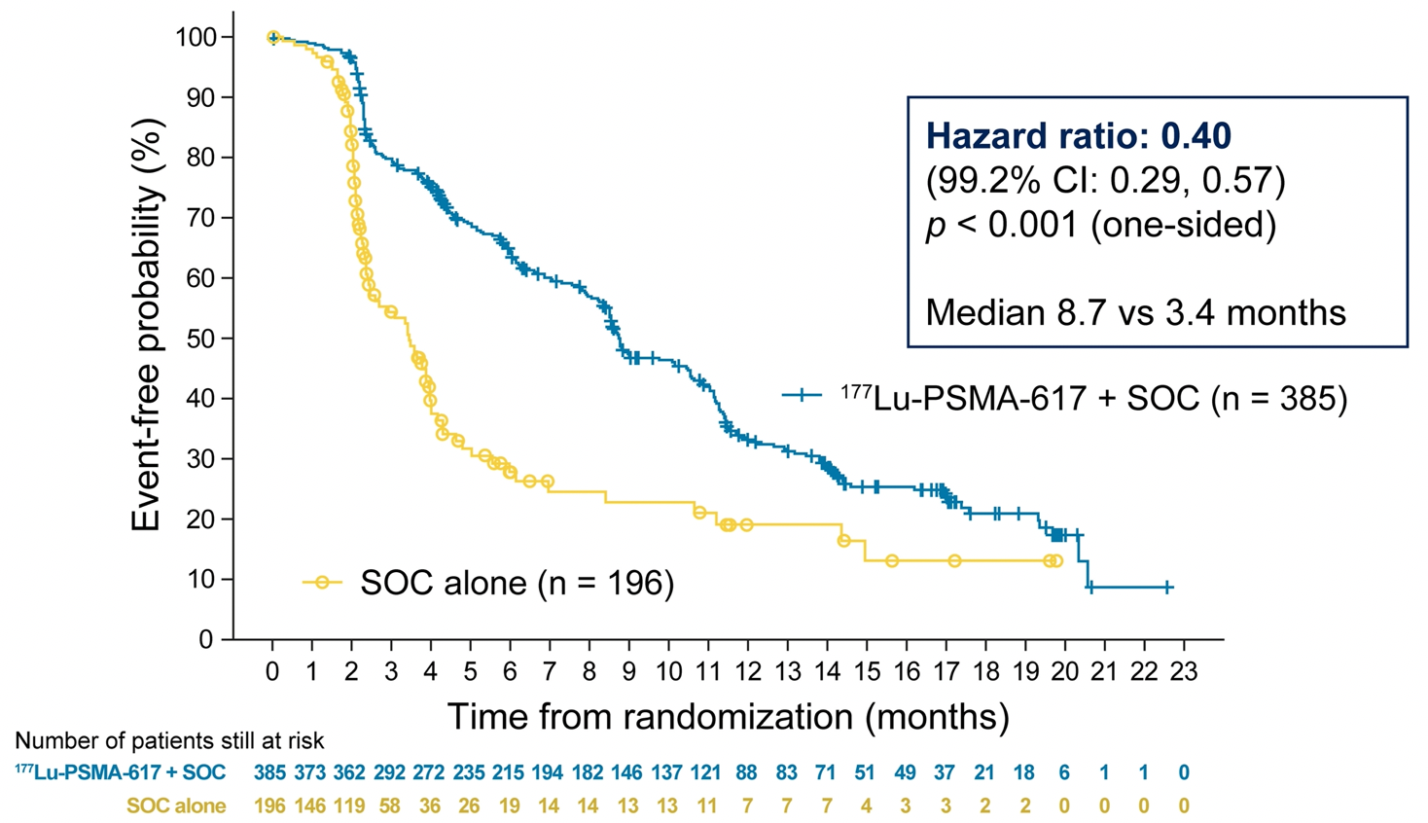
Progression free survival

Slide 25
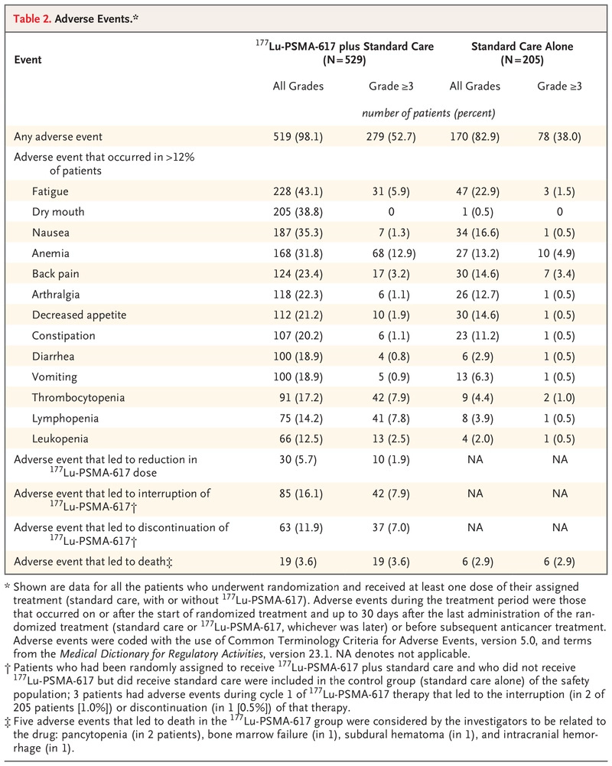
Adverse events – Sartor O, NEJM

Slide 26
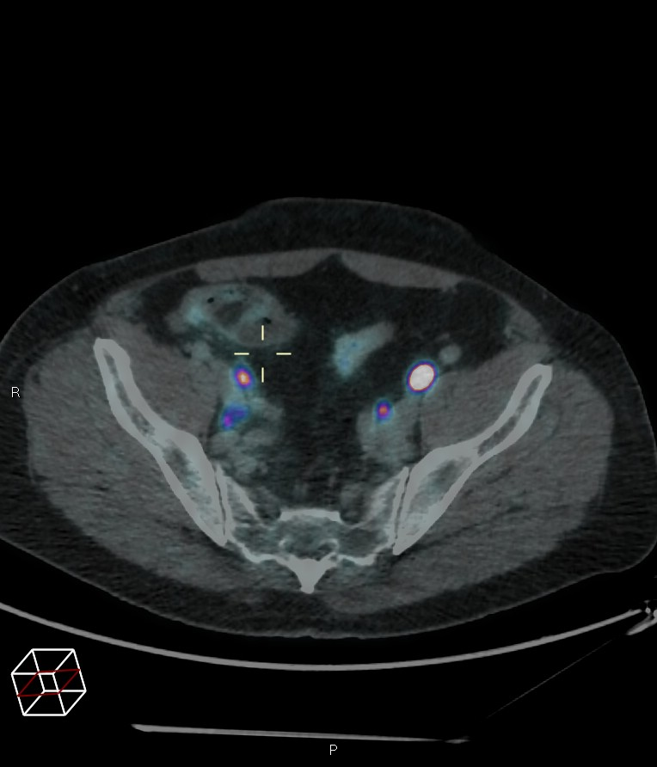
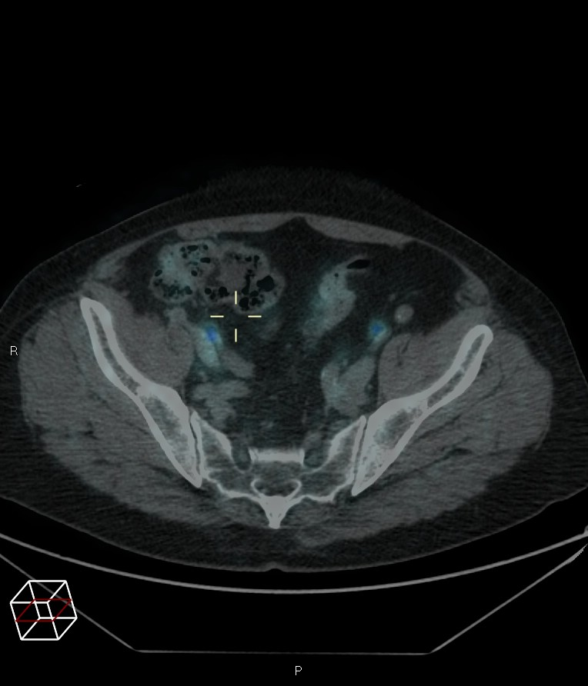
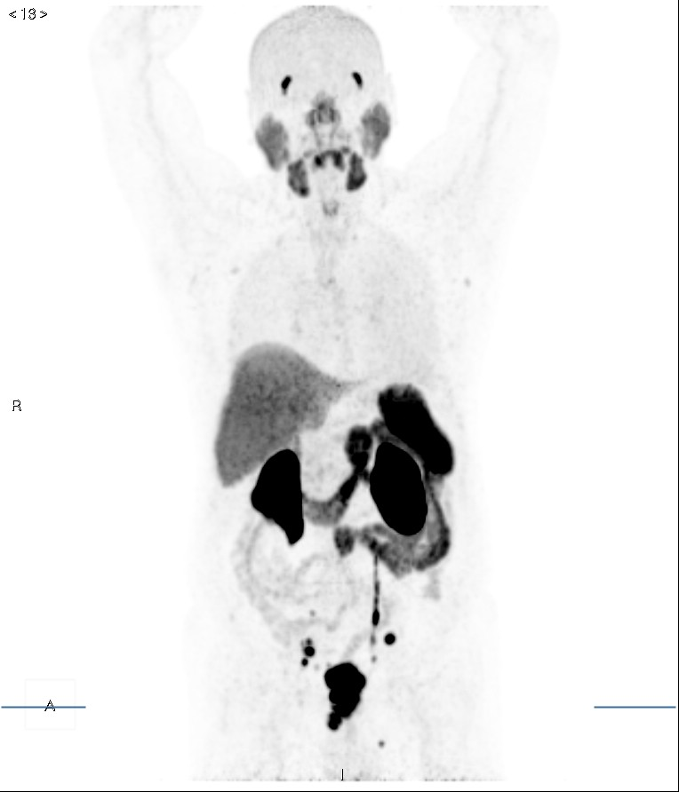
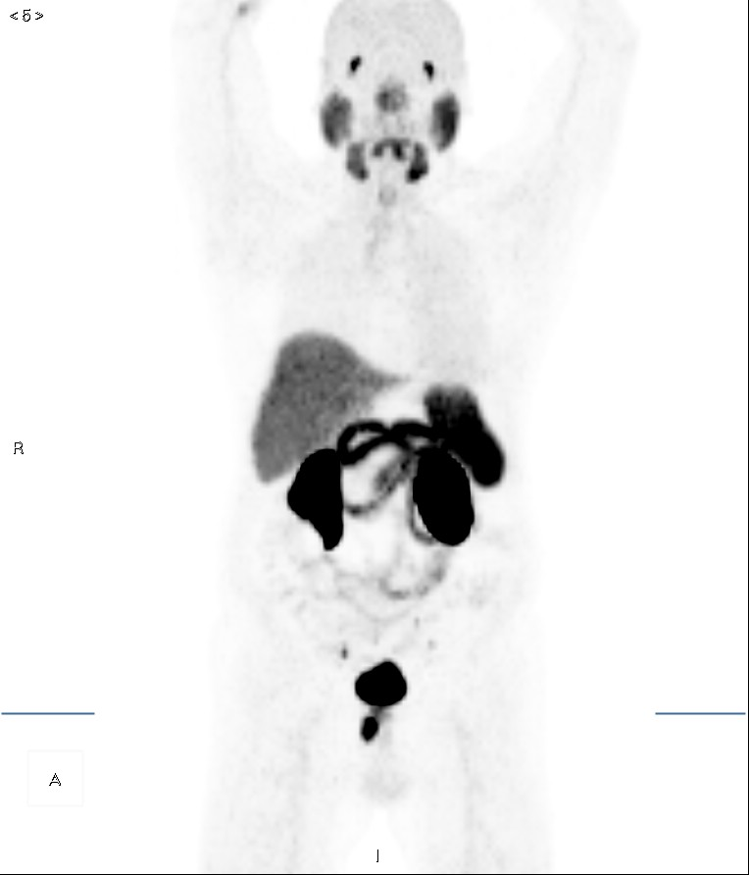
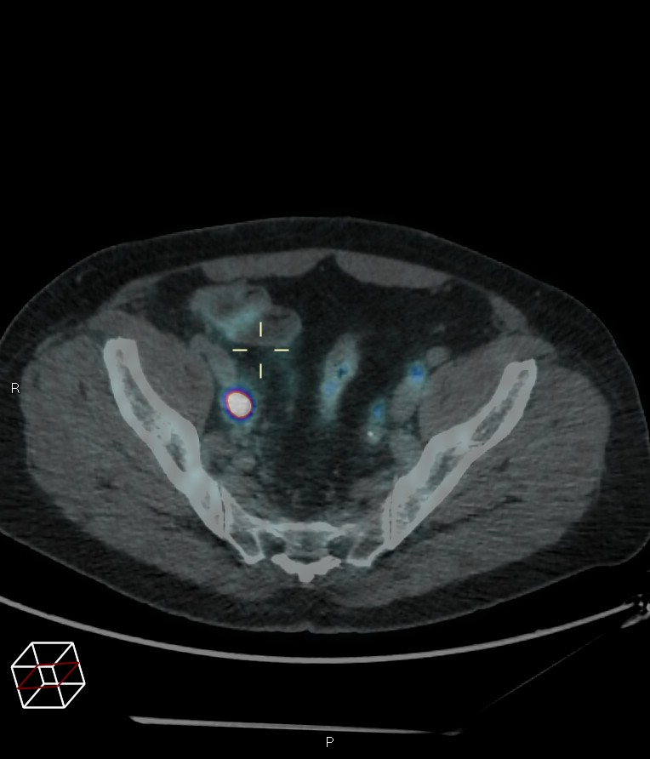
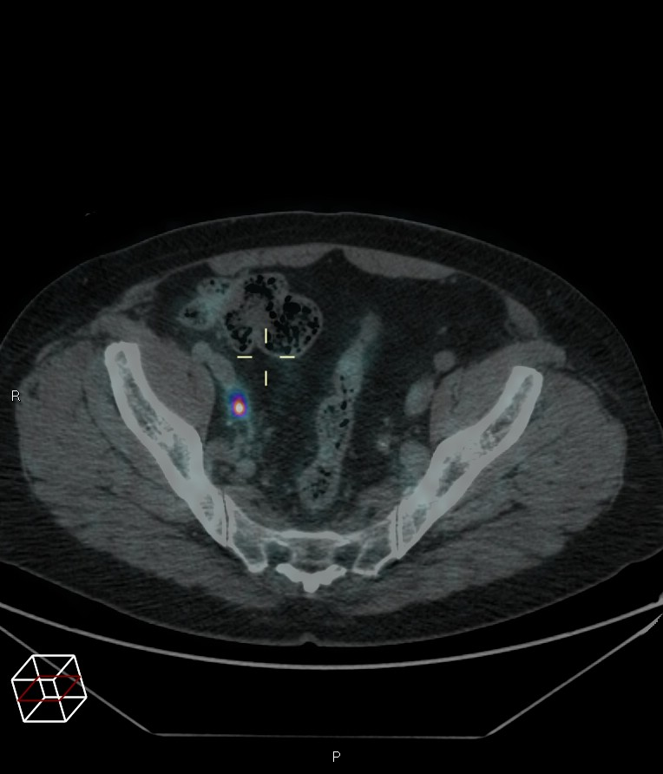
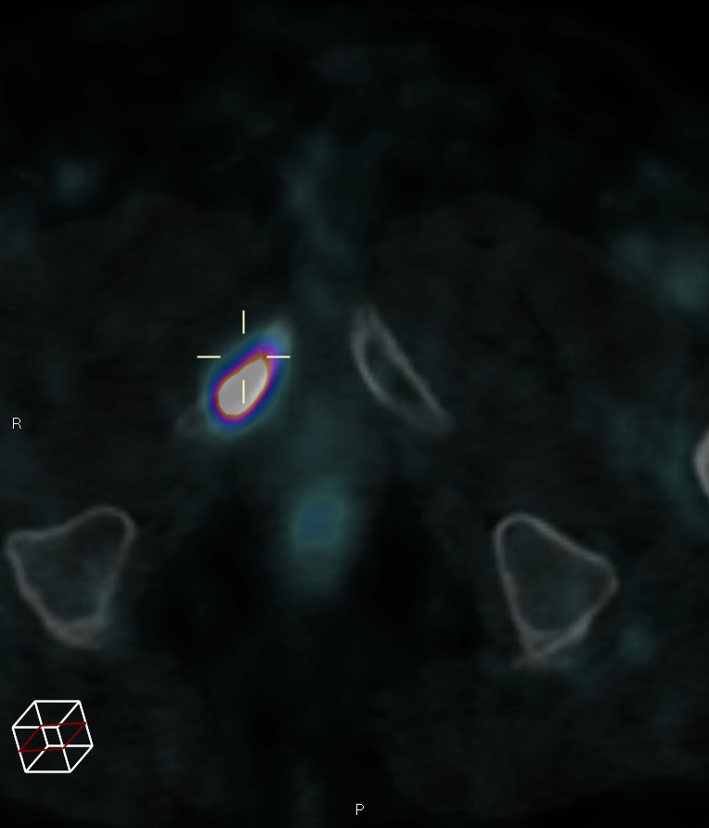
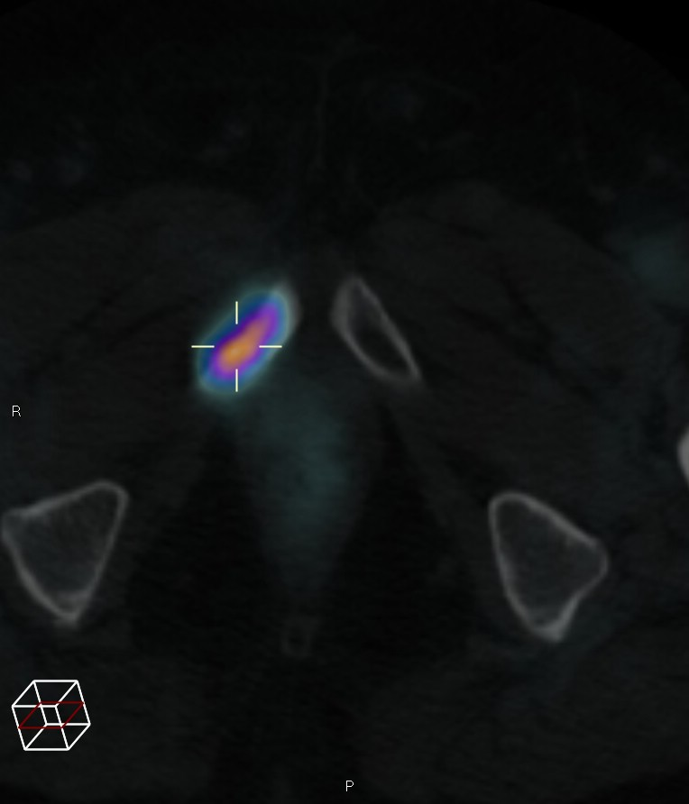
Patient treated with Lu-177 PSMA.
12/2017
PSA 33.8
07/2018
PSA 1.04
Pictures from Dr Voo, UCH, London

Slide 27
VISION trial summary
Overall a 38% reduction in death
Overall a 60% reduction in disease progression
Adverse events common when treated with Lu-177 PSMA
Symptoms related to salivary glands and GI tract
Toxicity to bone marrow
Mostly short lived by 12% patients unable to continue treatment
Data used for market authorisation and reimbursement

Slide 28
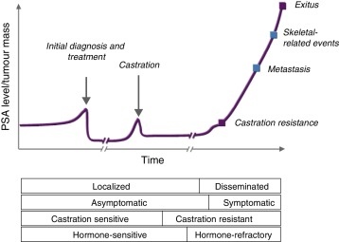
Trials with Lu-177 PSMA 617
Vision
completed
PSMA Addition in progress
PSMAfore
In progress

Slide 29
PSMA fore
PSMAfore study compares PFS in castrate resistant metastatic prostate cancer treated with early results show good results if used prior to taxanes
6 x 7.4GBq Lu-177 PSMA 617 compared to change of arberaterone or enzalutamide
468 patients recruited
Interim results Sartor et al Ann Oncol 2023 the median PFS for Lu-177 PSMA 617 group was 12.0 months compared to 5.6 months for changing arb or enza
Final results expected 2028
May mean patients treated much earlier in their disease

Slide 30
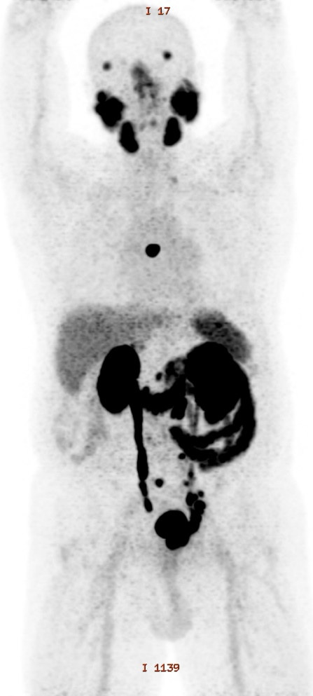
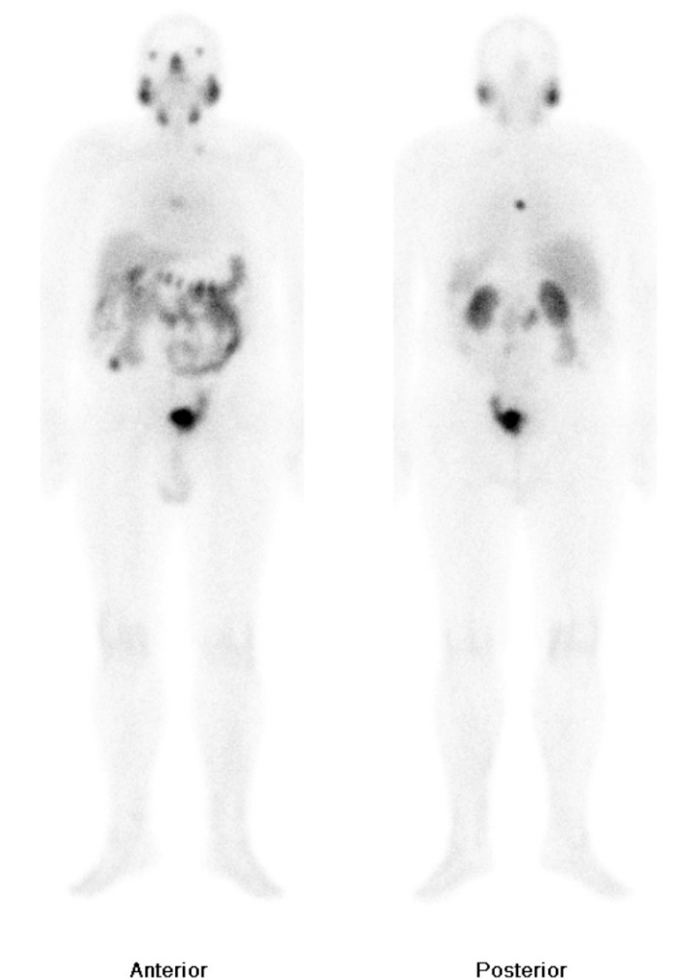
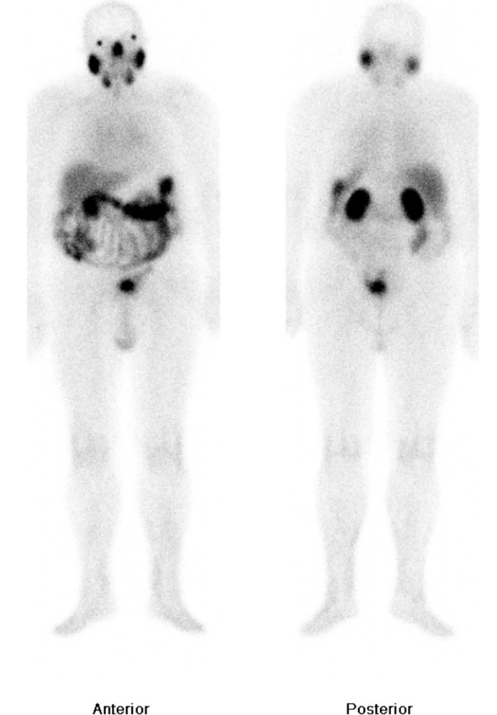
Patient of PSMA for trial
Ga-68 PSMA 1st Lu-177 PSMA 3rd Lu-177 PSMA
PSA 22 PSA 27 PSA <0.1

Slide 31

PSMAaddition
Looks at patients much earlier in the pathway
Looks at hormone sensitive metastatic prostate cancer who would normally be treated by arberatoerone or enzalutamide
1162 patients with hormone sensitive metastatic prostate cancer will be recruited
Half will receive Arb or Enzo
Half will receive Arb or Anzo and 4 cycles of 7.4 GBq Lu-177 PSMA 617
Primary end point is increased median PFS

Slide 32
Why do these studies
Saul Hertz and his followers showed early treatment of thyroid cancer with I-131 prevents disease recurrence
Small volume disease easier to treat
Also number of potential patients much greater maybe millions not thousands
$$$$$$$$$$$$$$$ for the drug companies

Slide 33
Other options change the radionuclide
Characteristics of some of the radionuclides being studied
Radionuclide | Physical characteristics | Notes
Lu-177 | T1/2 6.7 days 12% 0.5MeV beta | Used in 617
Tb-161 | T1/2 6.9 days 100% 0.6 MeV beta Also Auger and conversion electrons | In phase II trials
Ac-225 | T1/2 10 days multiple daughters 4 alphas , 2 betas max energy 7.1MeV | World supply limited
Pb-212 | T1/2 10 hours 1 alpha, 1 beta, 6.1 MeV | Limitless supply
At-211 | T1/2 7.2 hours alpha 1 beta 5.8MeV | Cyclotron produced

Slide 34
Second option change the carrier
Some of the carriers being developed
Ligand | Isotope | Localisation | Notes
PSMA 617 | Lu-177, Ac-225 | Glutamate analogue | Ac-225 in phase II
PSMA I&T | Lu-177, Ac-225 | Glutamate analogue | Lu-177 in phase III
J951 | Lu-177 | Antibody to e/cell PSMA | Phase II
Pelgifatamab | Ac-225 | Antibody to e/cell PSMA | In Phase I/II
TLX592 | Ac-225 | Antibody to e/cell PSMA | In Phase I
The antibodies have minimal salivary gland uptake and low uptake in normal liver

Slide 35
Moving to alphas will they work?
Very effective at tumour kill
Multiple radioactive daughters so more than one radiation decay per atom
Often good radiation protection characteristics
Can be very toxic
Needs precise targeting
Needs residency at target
Complex chemistry especially of decay isotopes

Slide 36
Actinium-225 PSMA Kratochwil et al JNM 2016
Looked at 2 patients who had failed to respond to Lu-177 PSMA
Treated with 100kBq/kg of Ac-225 PSMA every 2 months
Good response with PSA returning to normal
No BM toxicity by severe Xerostomia which did not recover

Slide 37
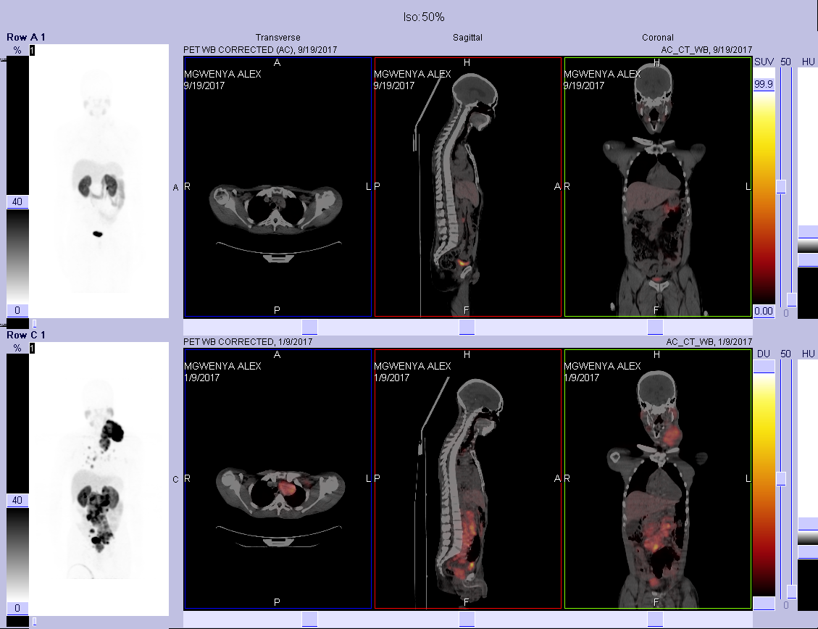
Pretoria Data on Targeted Alpha Therapy for Prostate Cancer
NB: Unpublished
2 x
²²⁵Ac-PSMA
April 2017
PSA = 1300,69 ng/ml
September 2017
PSA <0.05 ng/ml

Slide 38
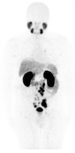
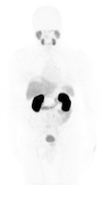
⁶⁸Ga/²¹³Bi-PSMA THERANOSTIC: The first-in-man treatment concept in a patient with mCRPC
A
B
²¹³Bi-PSMA
237 µg/L
12/2015
PSA
43 µg/L
02/2016
⁶⁸Ga-PSMA
06/2015
⁶⁸Ga-PSMA
07/2016
Sathekge et al. Eur J Nucl Med Mol Imaging. 2017

Slide 39
Sathekge et al EJNMMI 2019
Treated 17 chemo naive patients with
3 cycles of decreasing Ac-225-PSMA 617
First cycle 8MBq, then 2 months later 7MBq and 2 months after that 6MBq
16/17 had PSA response (14 >90%)
15/17 showed >50% decrease of lesions on Ga-68 PSMA PET
Two major toxicities BM in patient with bone mets and renal tox in patient with single kidney

Slide 40
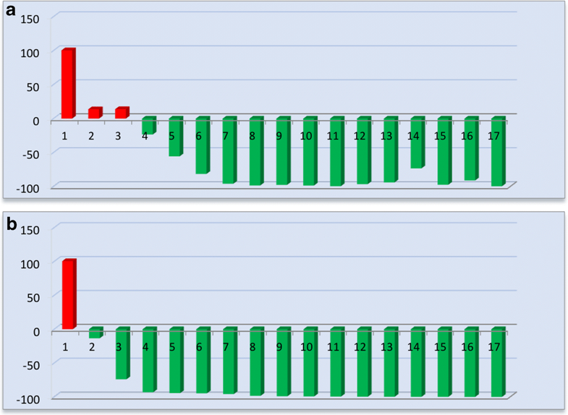
Waterfall plt of PSA response 8 weeks after 1 cycle Ac-225 PSMA 617 and best response Sathekge et al EJNNMI 2019

Slide 41
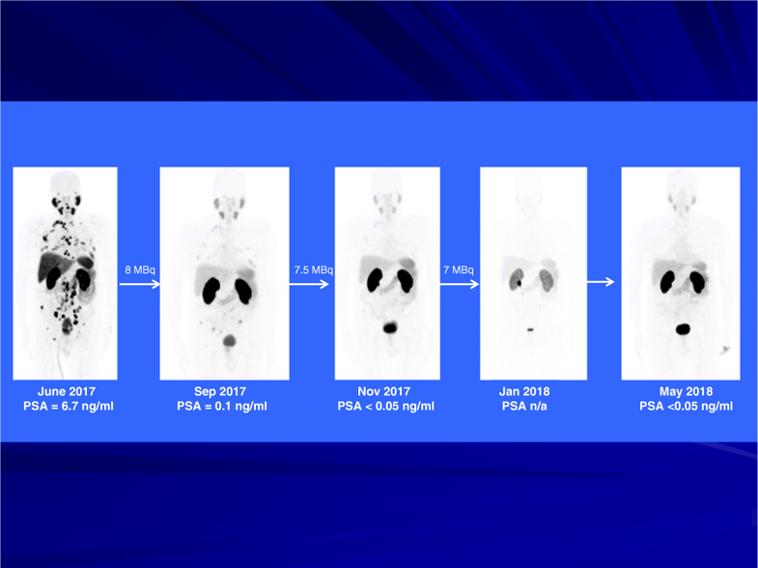
Response to 3 cycles Ac-225 PSMA-617
Sathekge et al EJNMMI 2019

Slide 42
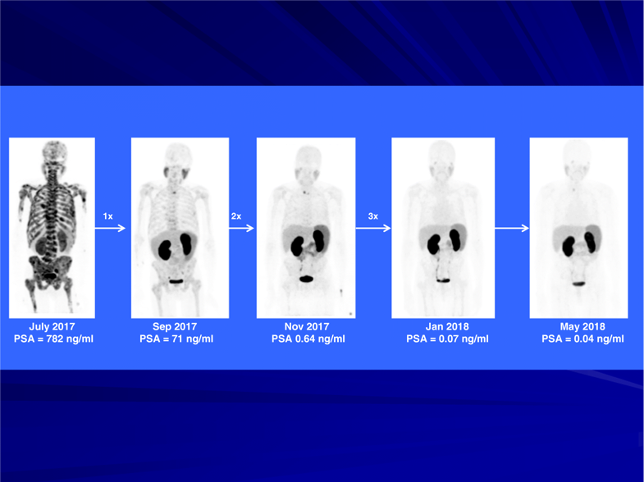
Response to 3 (8/7/6 MBq) cycles Ac-225 PSMA-617
Sathekge et al EJNMMI 2019

Slide 43
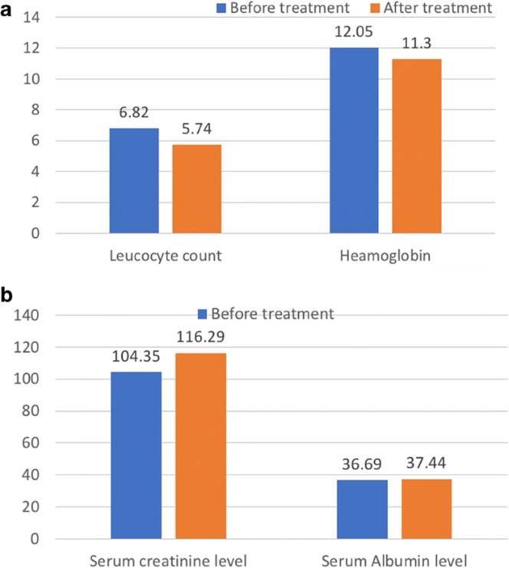
Toxicity in 17 patients treated with Ac-225-PSMA-Sathekge et al

Slide 44
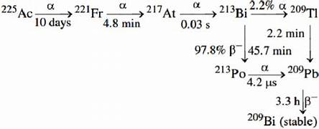
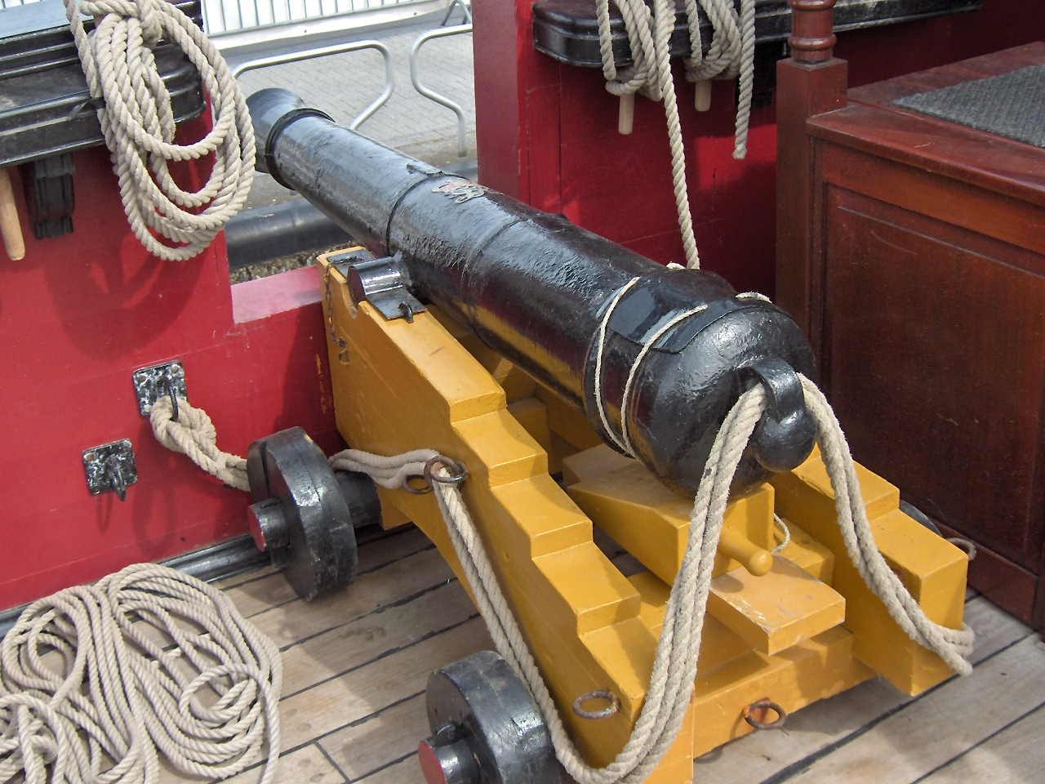
The problem with Ac-225
Very complex decay
No evidence that daughters stay on PSMA molecule
Problem of alpha recoil
May contribute to toxicity
Supply difficult only 100 patients/year

Slide 45
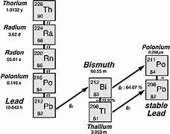
What about Pb212
Lead 212 is an alpha emitter which
Comes from Thorium-225
Thorium-225 can be loaded into a generator which lasts 2-3 years
Simpler decay

Slide 46
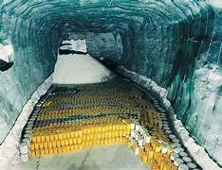
Where can be get Th-225 from
Each barrel of radioactive waste from a nuclear power station contains kg of Th-225
Needs to be extracted (mined)
Projects around the world looking at this
Basically endless supply
Each barrel 1 m high, this old mine has 10,000 barrels in it

Slide 47
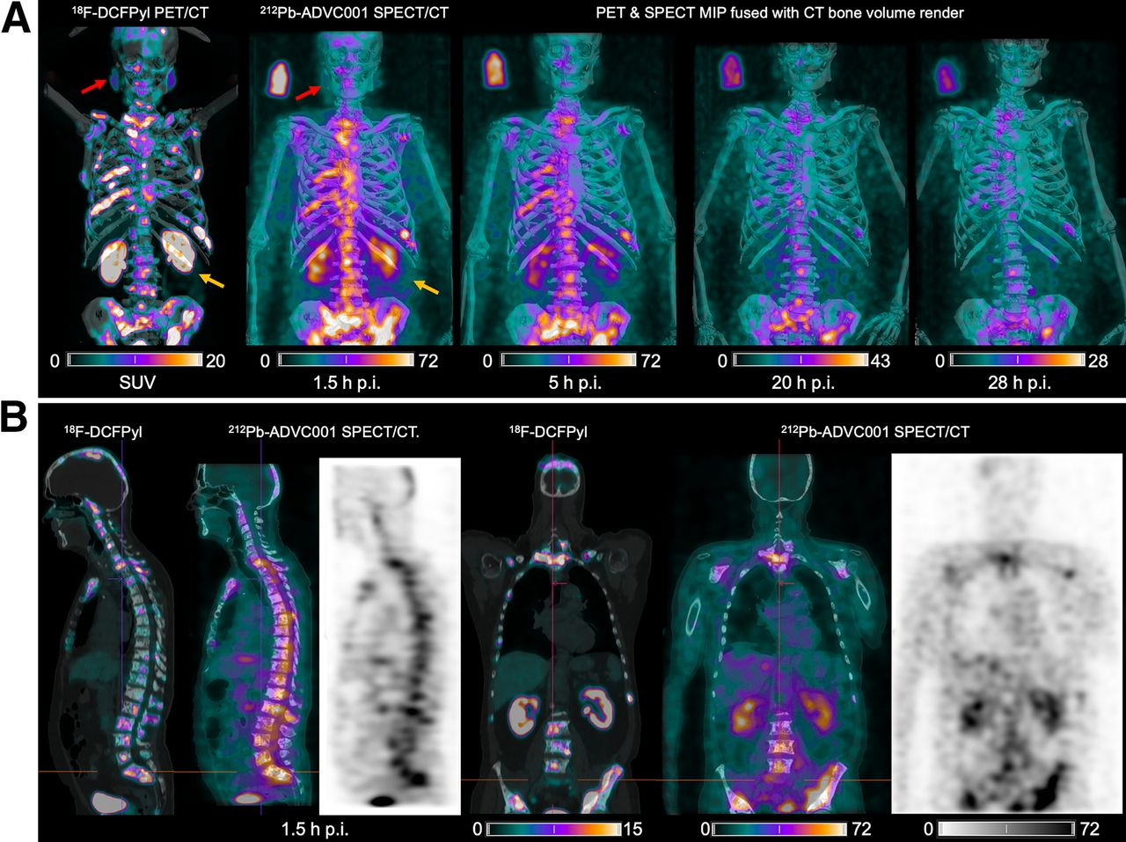
F-18 PSMA and Pb-212 PSMA a theragnostic pair
Griffiths et al from Australia showed uptake of Pb-212 ADVC001 similar to F-18 PSMA JNM 2024

Slide 48
Summary Lu-177 PSMA
Early promise of Lu-177 PSMA therapy as third line treatment justified
Phase 3 trials shows survival benefit on average 3 months
Used as 3rd line treatment
New trials to look at its use in neo-adjuvant and early stage scenarios due to good safety profile
Trials started with Ac-225 PSMA
Maybe Pb-212 will be way to go
Lots of investment and soon lots of work

Slide 49

Thank you for all your support over the past 14 years

